Slide 1
C343 MiniLudu
Paul van Sittert
Stavros Koumpounis

Slide 2
Requirements
Create a MiniLudu game using double linked lists.
4 players moving round a board, with an anticlockwise movement in the outer board, and clockwise in the inner board.
Each player starts in a different location, and follows a slightly different path.
Each player will be given a chance to throw a 4 sided dice to move their piece.
Player landing on other players, who aren’t in a safe zone will take place of the player, and send the other player back to their start.
Players have to land exactly on the centre of the board to win, and three players must win to end the game.

Slide 3
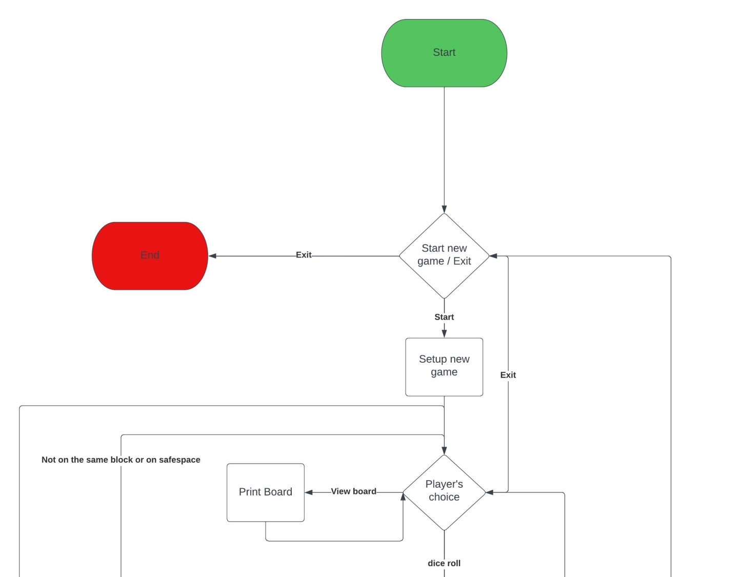
Flowchart
Notes:
We started designing our game with forming a flowchart.
You can see the game starting with a decision loop checking for the option to start a new game or exiting.
After a new game is started the process of setting up the game follows and leads to a decision loop presenting each player with their options
One of the options is to print the board

Slide 4

Flowchart
Notes:
Following to the 2nd option, which is the dice roll, the player basically take their turn.
This starts with comparing the player’s position to check if the roll places them over the board or if they land in final block making them finish the game.
If not the game continues with the player’s turn and moving them on the board.
If the position is at a set value the algorithm moves the player one layer inside otherwise it moves them ahead.
After the move there’s another decision that checks if another player is already occupying the node the player lands on.
If that’s true the other player is killed and sent to their starting position(homeNode)
When a player reaches the end they are marked as a winner and taken off the game
Eventually 3 players will have finished the game which will lead to the breaking of the player’s choice loop and lead back to the main menu.

Slide 5
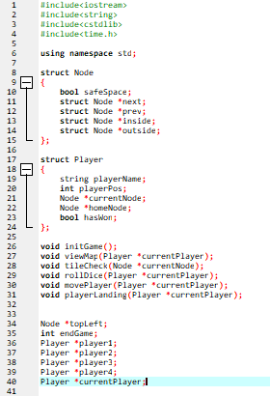
Variables
Notes:
1.Going into the code, we started by initialising our structs. 2.The Node struct used for the board includes a Boolean for it being a safe space and keeps pointers to the next,prev and inside nodes. 3.Our player structs holds the relevant variables for each player such as tracking the currentNode they’re on holding their homeNode and a Boolean hasWon marking them for having finished the game. 4.We then declare a topLeft Node marking the starting point of the game board 5.Along with the endgame int counting the players that have finished the game 6.And 5 player objects for each player and the current one

Slide 6
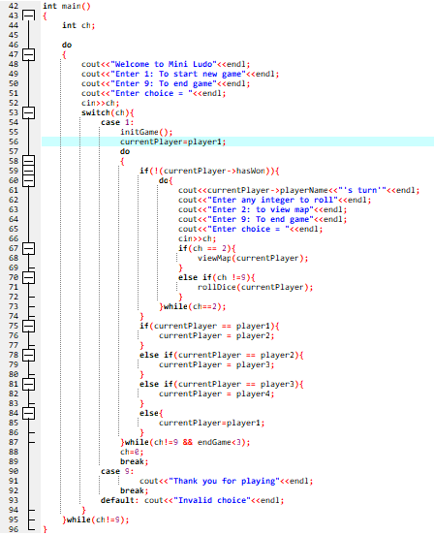
Main
Notes:
We started with the main function handling the menu and the navigation of the game.
This follows our flowchart with giving the option to start a new game or end the game altogether.
There's an initial switch statement handling the 1st options.
In case 1 a new game is initialised currentPlayer starts with player one.
We enter a do while loop to emulate the player's choices for rolling or viewing the map.
The rollDice function is executed for any integer and acts a turn taking function and exits the do while after the turn has been taken.
Then a few conditionals are setting the turn to the next player.
If a player has finished the game their turn is being skipped with an if conditional.

Slide 7
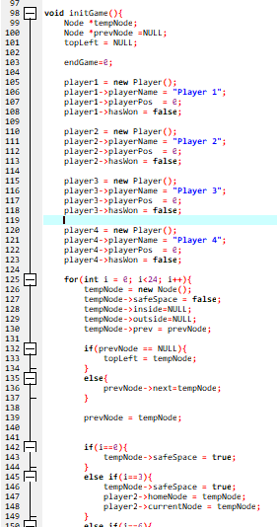
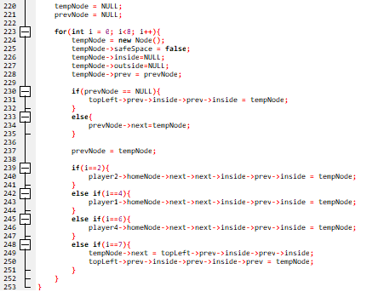
Init
Notes:
We start with initialising our variables, players and a temp Node.
We then take up forming each layer of the board starting with the outer layer containing 24 nodes.
We're resetting the tempNode
If prevNode is null that means we're at the start of the board and we initialise the topLeft node.
Else we initialise prev-> next and prev to the tempNode
We that have a line of conditionals to initialise the safe spaces appropriately on the outer layer.
And also set the players on their related home position which is also the current position.
We finish with connecting the layer in both ends if I == 23.
We follow a similar reasoning for the first inner layer.
We start by setting the node going inside at the start of the layer.
We then follow with setting the safe spaces and the related nodes where each player enters the inside layer.
Finally we handle the innermost layer following a similar logic to the initialisation of the inner layer.

Slide 8
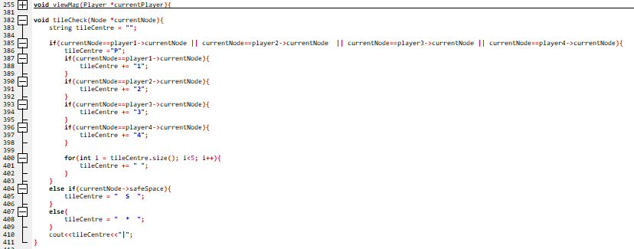
Tile Check
Notes:
The Tile Check function checks the contents of each tile and outputs the correct string to display the contents.
The View Map function is used to call the Tile Check for each tile, and add a few pieces of formatting.

Slide 9
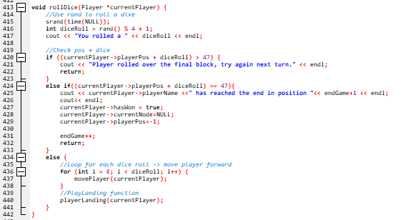
Roll dice
Notes:
The dice roll function generates a random number using the rand function.
This randomly generated number serves as the digital replacement for rolling an actual dice.
The game then checks if users would land past the end goal, if they do their turn is skipped and they don’t move.
If the user lands on the end goal, they win the game and move their piece off the board. Their position is also displayed.
If the user’s position + their dice roll is less than the end goal, then a loop is called that moves their piece 1 space forward at a time for the amount the dice has rolled for.
The player landing function is called, to check if the user landed on another player.

Slide 10
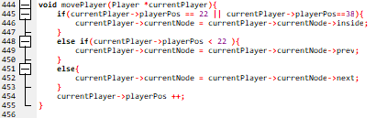
Move player
Notes:
The movePlayer function is in charge of changing the players position on the board.
The function checks the current position of the current player, and if the are on spaces 22 or 38 it will cause the players piece to move into the next layer of the board, rather than continue moving round the board.
Else it moves the player to next position on the board, moving anti-clockwise before position 22 and clockwise after position 22.

Slide 11
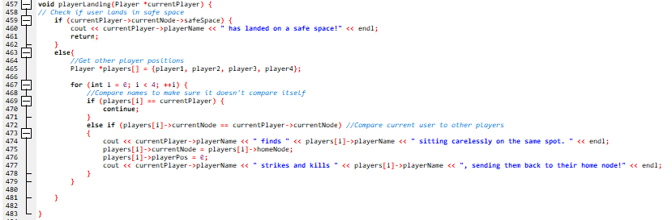
Player Landing
Notes:
The player landing function, checks the position the player has landed on.
If the user lands on a safe space, and appropriate message is output.
Otherwise the game checks if the user has landed on another player, and if they have, moves the other player back to their starting position.

